Slide 1
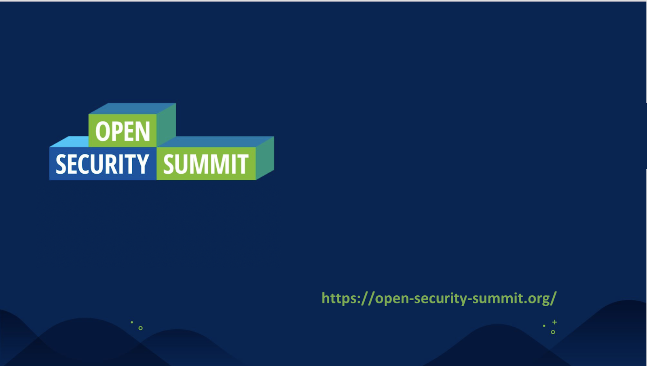
Cloud Security 101
Kriti Mohun
Security Engineer | Check Point Software Technologies
https://uk.linkedin.com/in/kritim
Notes:
Wait for people to arrive before starting - Hello, thank you for joining us today on this cloud security 101 pre-summit training. Thank you for the organisers – Didar for having me.
Short introduction for myself, my name is Kriti Mohun, work as a security engineer at Check Point for the last 6.5 years, and before Check Point I was with Qualys, on the vulnerability management side of things. Prior to that, I was a Cisco firewall administrator.
Let’s get started with slides:

Slide 2

Agenda
Cloud Security Mindset
What lives in the Cloud ?
Cloud deployment models
The limitless possibilities of cloud services
Cloud attacks examples
Overall Cloud Security Posture
Assets safeguarding in the cloud
Demo & Hands-on Labs of Check Point Dome9 – cloud visibility and regulatory compliance
Include learning objectives from this session
Adapting to cloud security mindset
Real world problems / challenges with cloud security
Your position in cloud security
Asset Management, Identity safety, regulatory compliance in multi cloud environment
Cloud Security using Check Point Dome9
Notes:
If you have a question in between, please do send your question in the chat, and I will take them as we go along or after the sesh, depending on how we are doing for time.
There is one fundamental question – how many points of entry or back doors are being opened?

Slide 3

Key: How many points of entry, back doors are being opened ?
Notes:
And most importantly if there is anything I want you to remember throughout this sesh – is this question – how many points of entry, back doors are being opened ?
This question is key for any person working in the security industry, and I so often, see, we all being tech, we jump to solve a specific tech issue – ACLs requires fine tuning, Logs and monitoring need stepping up, but there is one key question every single security personnel does is to step back and ask and that is – how many points of entry, back doors are being opened ?
This single question leads to finding the correct answer.
So remember this point I will be quizzing this throughout ☺
Let’s move on to start out cloud security 101 sesh

Slide 4
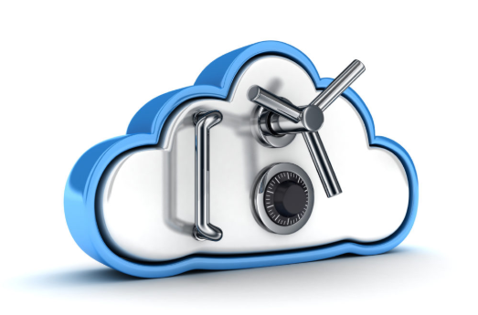
What’s in it ?
Protect your data, protect your assets
Infrastructure is shared – trend of using multi cloud platforms
Different service cloud model requires different Cloud security approach
Ever expanding cloud services in different environments
Freedom to manage cloud/cloud segments/different platforms
DevOps, BI, IoT solution hosting
Agile
Elastic
Cheap
Resilience
Ease of Deployment
Notes:
What’s in it ? Cloud has a certain few very peculiar characteristics – it is agile, elastic, cheap, resilient, and comes with a high level of ease of deployment. But why is security so important in the cloud ?
Cloud data security is vital.
Cloud security is important for both business and personal users. Everyone wants to know that their information in the cloud is safe – that they will not be hacked, and that the fact you have trusted an infrastructure provider to host your data, should not in anyway cause your business reputational damage. Often the cloud infrastructure is shared, and some of your data may even hosted on multi cloud platforms.
The Cloud also provides an ever expanding amount of cloud services, and the freedom to operate multi cloud.
So we spoke of the characteristics of the cloud, and shared infrastructure, what does shared infrastructure actually means ?

Slide 5

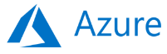
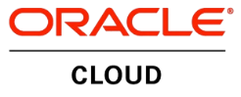

Cloud = Shared Responsibility
Customer Data
Customer responsible for security in the cloud
Platform, Applications, IAM
Operating System, Network and FW Configs
Client-side Data Encryption & Data Integrity Authentication
Server-side Encryption (File System / Data)
Network Traffic Protection (Encryption, Integrity, Identity)
Cloud vendor responsible for security of the cloud
Compute
Storage
Database
Networking
Cloud Global Infrastructure
Regions
Edge Locations
Availability Zones
Notes:
Shared infrastructure model actually means shared responsibility
Shared responsibility means that the cloud providers protects their underlying infrastructure and you, as a customer, have responsibility to protect your data operating systems and applications
shared responsibility, means that cloud customers are responsible to safeguard – protect their Data, protect the connected people, working onto the respective cloud platforms and some of the infrastructure (like OS and network configurations).
In a multi tenant cloud environment, there may be multiple administrators/users working on multiple parts of a project – some could be working on the application, some on the networks, some in the back end. To the business, this is what makes cloud attractive, but at the same think for a security person – ” how many points of entry, back doors is being opened ?”
?
As we have mentioned public cloud, and im sure some of you are saying, there are other types of clouds too – let’s take a look at the types of cloud deployment models

Slide 6
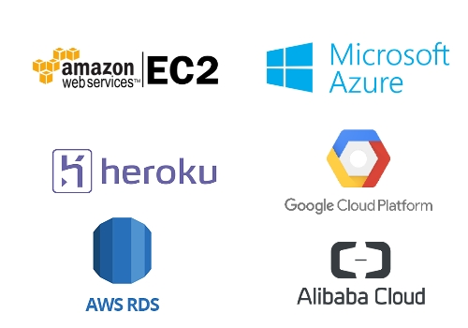
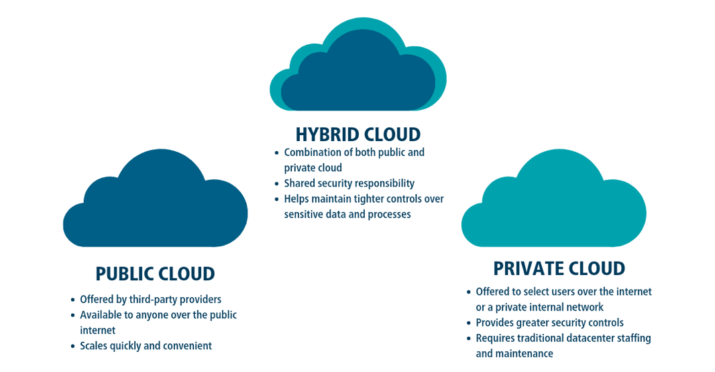
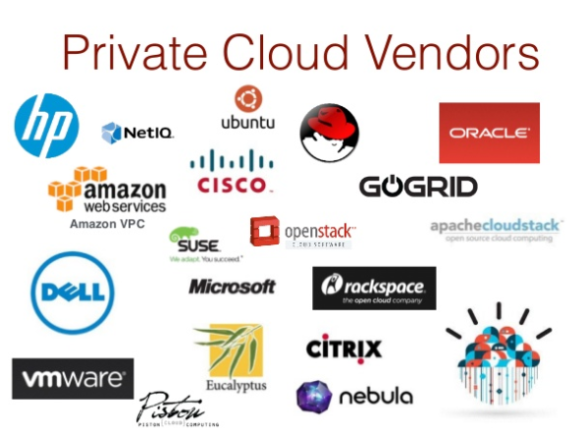
Types of Cloud Deployment Model
Public Cloud Vendors
Notes:
Public cloud vendors - is the most common form of cloud deployment model. In this deployment model, a service provider makes resources available to public via internet. In this case, as a administrator you don’t have to worry about the local hardware cost or keeping the local hardware up-to-date. This provides an opportunity of scalability and resource sharing that would not have been possible for a single organization to achieve. A common use case scenario is deploying a blog or a web application. Some of the common Public Cloud providers include Amazon Web Services, Microsoft Azure, Google Cloud Platform and IBM Cloud.
In Private Cloud, one creates cloud environment in its own data-center and provides self-service access to compute resources for its own organization. Unlike Public Cloud, whose resources can be used by multiple organizations. Private Cloud platforms provides resources to solely one organization and they cannot be shared with other organizations (also known as single-tenant environment).
Hybrid Cloud is a combination of Private and Public Cloud. It tries to leverage benefits of both type of cloud platforms, allowing you to run your application in most appropriate location. Hybrid Cloud is essentially useful when some data cannot be put in cloud due to legal reasons. Its also useful when you want to keep old hardware/system running locally for applications which run on old hardware that cannot be updated. For instance, you can deploy your website on a public cloud to leverage scalability, and could deploy database in private cloud to secure the data
Let’s take a look at the cloud service deployment model

Slide 7
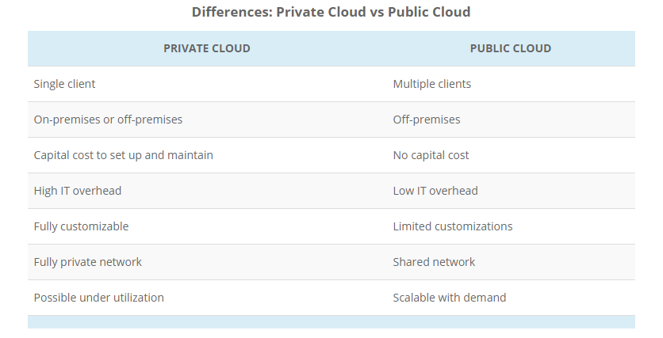
Difference between Private and Public Cloud

Slide 8
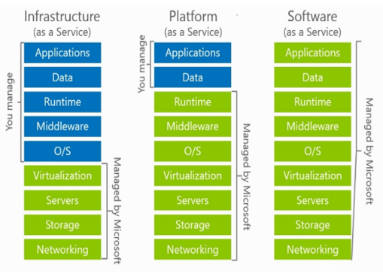

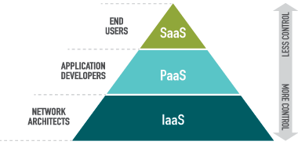
Types of Cloud Service Models
Notes:
Each type represents a different kind of service level and our control over that resource.
In a On Prem - private data center, we are responsible to set up and maintain everything. We need to set up a networking stack, prepare and configure storage, buy and prepare hardware, install software, and configure the virtualization host. Then we need to configure images and servers, and deploy and manage databases. Security is also our concern in all aspects—physical security, network security, host and OS security, and finally application security for all application software running on our servers.
With IaaS, it gets easier. We don't have to prepare anything anymore; all we need to do is sign up for a subscription and create a virtual machine when needed and start using it. The part where we must buy, prepare, configure, and maintain is no longer our concern and the cloud service provider takes care of that, in this example, Microsoft Azure. Preparing images and deployments is also no longer our responsibility. Security gets easier and physical, network, and host security are handled by Microsoft. We still have a responsibility in the security corner in order to keep our operating system up to date, patched, and secure.
Application security is very often overlooked. Neglect. When moving to the cloud, it is important to remember that resources and applications are publicly exposed and will experience significantly more "attacks" compared to when using on-premises infrastructure. Attacking resources on-premises usually means getting behind a firewall, then breaching the server and getting some data out.
PaaS is getting even easier to use than IaaS- Microsoft is taking care of the operating system, additional software needed, and an additional layer of security. As the cloud business administrator you are required to still to maintain everything that is placed in the cloud (depending on the PaaS service) and the part of security still remains our problem. Again, people forget that security part very quickly as even more responsibility is on Microsoft.
Finally, we have SaaS. In SaaS, the cloud service provider is taking care of almost everything, from end to end. In this case, we have a complete solution prepared and all we have to do is create a subscription and assign users different kinds of access. Usually, SaaS has to have modules, an administrator, and a user. The administrator module is used to manage users and access levels; the user module is used to actually use the software feature we subscribed to. Security stays our responsibility, only on the user level, and we need to make sure users are aware that they need to keep their credentials safe and their password strong enough, Use MFA to prevent accounts being brute-forced into. The best example of SaaS in Microsoft Cloud is Office 365
Serverless computing is not, despite its name, the elimination of servers from distributed applications. Serverless computing enables developers to build applications faster by eliminating the need for them to manage infrastructure. With serverless applications, the cloud service provider automatically provisions, scales and manages the infrastructure required to run the code. Developers bring their own containers to fully managed, Kubernetes-orchestrated clusters that can automatically scale up and down with sudden changes in traffic on spiky workloads.

Slide 9
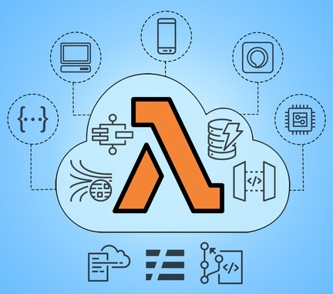
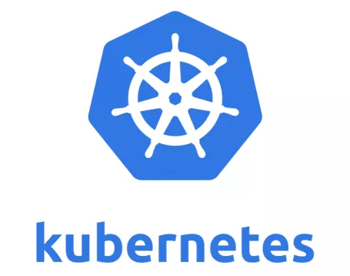
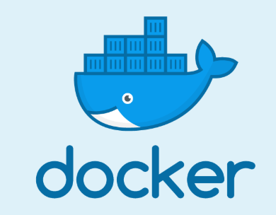
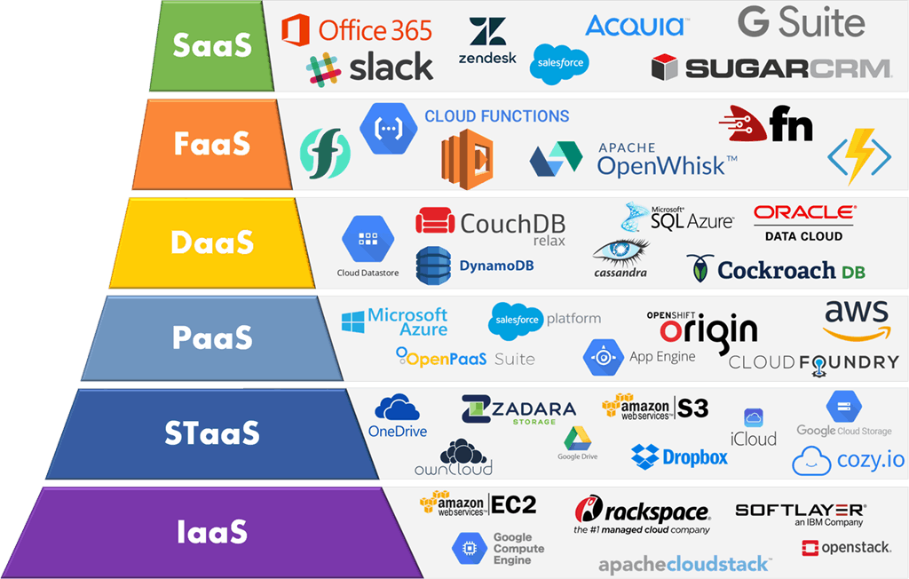
Notes:
As you can see here, from the just the days of IaaS PaaS Saas, the service models are increasing on a daily basis. Storage as a service, DB as a service, Function as a server, serverless, and so forth. With an every growing list like this, we as security administrators must make sure, we are applying the correct level of security to safeguard our applications, data, and users connecting/connected in the cloud.
As colourful as this picture looks – the question remain the same – with your data being the cloud how many point of entry, back doors is being opened ? And this leads to the question -
”

Slide 10
Cloud Attacks
Are cloud services easier to hack ?
Accessibility to cloud platform
- Log from anywhere via web browser
- Multi user access
- lack of Identity Access Management
- Root account credentials access
Misconfiguration
Unencrypted storage / DBs
Visibility – Lack of Asset management
Insecure interfaces and APIs
Security compliance
Phishing / Spear Phishing
Web API attacks
Supply Chain attacks (Watering hole)
Man-In-The-Cloud
Cloud Malware injection Campaigns Advanced persistent threats (APTs)
Denial of service attacks
Notes:
CP research - New phishing campaigns discovered impersonating the WHO and popular conferencing platforms, to steal sensitive information. Check Point has seen 192,000 coronavirus-related cyber-attacks per week over the past three weeks, a 30% increase compared to previous weeks In the past three weeks, almost 20,000 new coronavirus-related domains were registered: 17% of these are malicious or suspicious
A watering hole attack is a security exploit in which the attacker seeks to compromise a specific group of end users by infecting websites that members of the group are known to visit. The goal is to infect a targeted user's computer and gain access to the network at the target's place of employment. The name watering hole attack is inspired by predators in the natural world who lurk near watering holes, looking for opportunities to attack desired prey. In a watering hole attack, the predator lurks near niche websites popular with the target prey, looking for opportunities to infect the websites with malware or malvertisements that will make the target vulnerable.
Cloud manlware – spectre and meltdown a few years ago
Web API attack – one to watch out for – esp. considering many of the tasks in the background not visible to end uers are completed over web api’s – it’s easy to compromise - Injection Attacks. ...
Broken Authentication. ...Sensitive Data Exposure. ...Broken Access Control. ...Parameter Tampering. ...

Slide 11

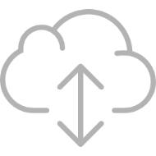

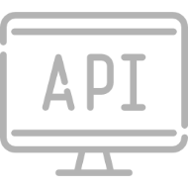

THIS MIGHT EXPOSE YOU TO…
Lateral threat movements
Data breach due to misconfiguration
Abuse of cloud services
API hacking
Malicious insiders

Slide 12

The Big Question ?
Cloud Security Architect
Cloud Security Engineer
Cloud Software Engineer
DevOps
Cloud System Administrator
Cloud Product Manager
Cloud Consultant
CISO
CIO
Notes:
Now you know how vulnerable cloud is, it is important to know – who are you, i.e what is your position and responsibilities. Different functions require different set of skills, the objective pretty much stays the same.
Depending on which function is your responsibility, as part of this diagram, the functions are much different to each other, this slides is a representation of cloid security framework by CSA to demonstrate all the different components and entities do form part of a cloud project, security is a small yet, important part of it

Slide 13
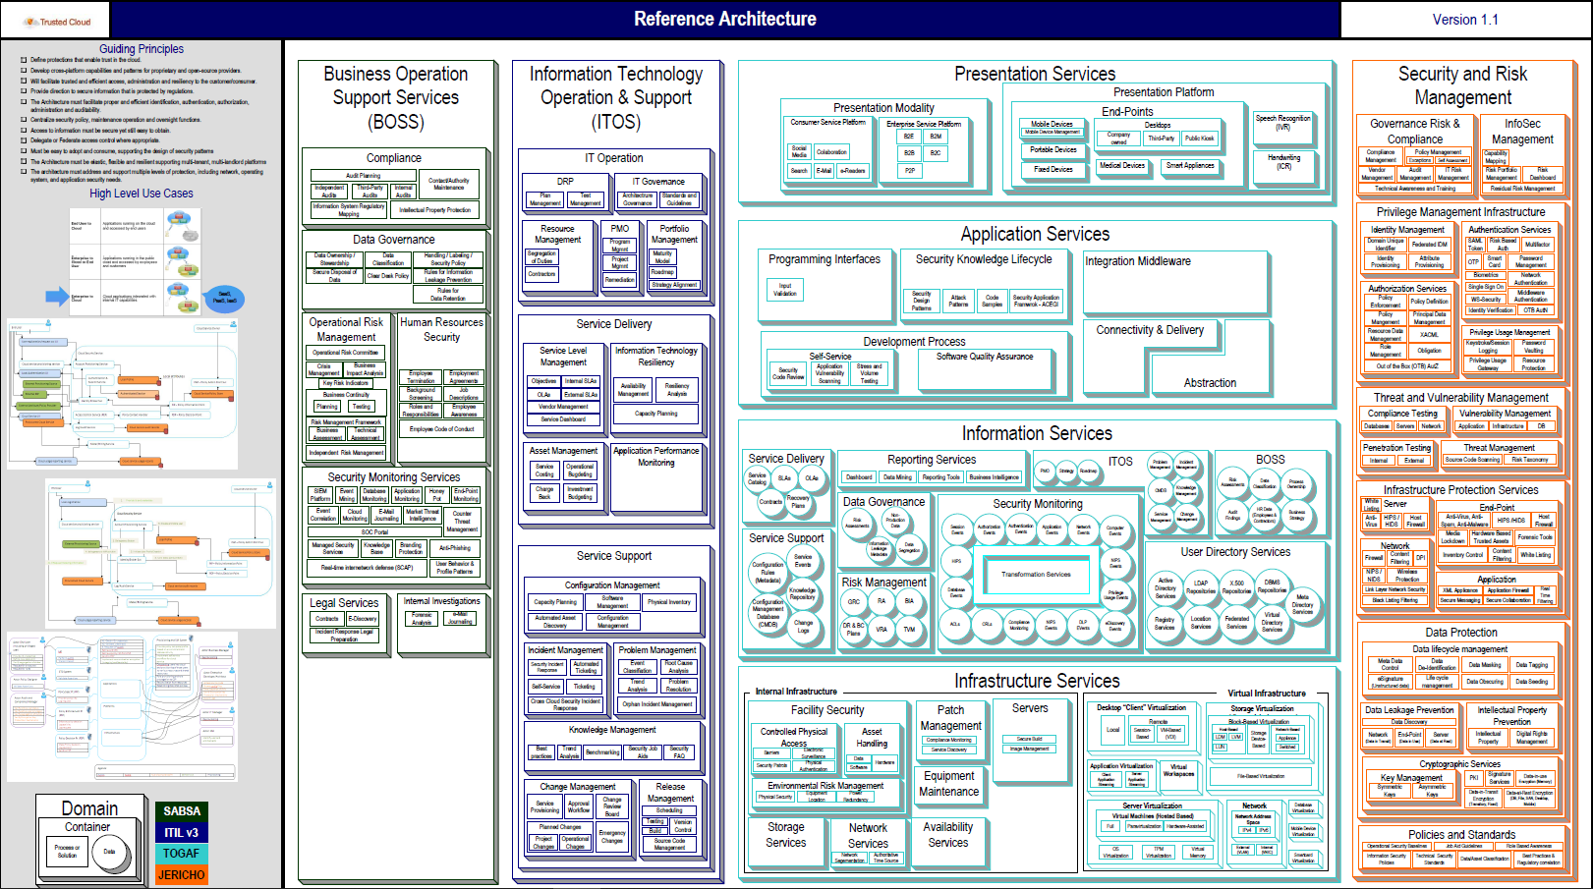
Notes:
Let’s take a look at DevOps

Slide 14


INNOVATION IS THE KEY TO SUCCESS
DevOps IS THE NEW BLACK
Developers:
Freedom
Agility
IT Operators :
Control
Efficiency
DevOps
Cloud Applications are no longer manually deployed or configured; they are orchestrated.
Notes:
You are part of operations team and work closely with 2 key stakeholders: IT operators and developers . The new team are working together as DevOps. One key function of devops is to automate tasks. Cloud applications are no longer manually deployed, rather they are orchestrated. What that mean, it means that the devops means has create a set of APIs or automated tasks calls which deploy as when those bits of application are ready.
Some of the challenges – are that the curren,the legacy principles work no more on the cloud sets, let’s take a look why.

Slide 15

Why legacy security is hard to deploy in the cloud ?
Hard to deploy security in the cloud
Firewall tickets are bottleneck
Cloud is dynamic and security is static
Notes:
But the legacy security can’t work in the dynamic nature of the cloud, opening tickets for the teams are bottleneck, in an on-prem environment

Slide 16

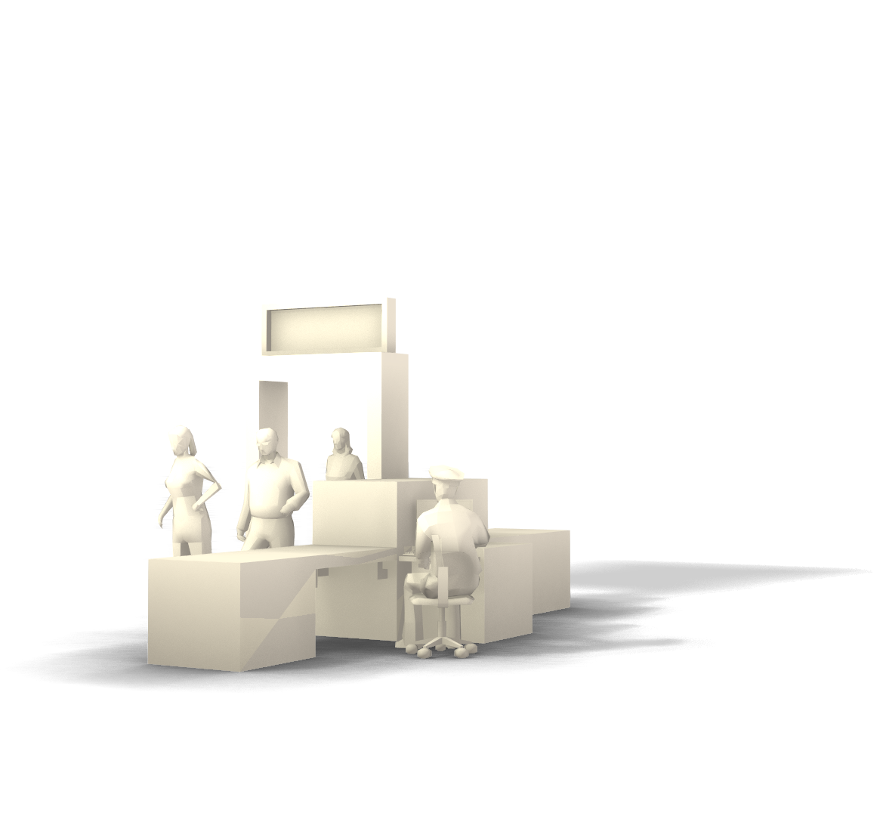
What’s your cloud security needs ?
Security must be as agile as your cloud
…..and it must be effective!
Notes:
So what you are looking for 1. security which is dynamic, easy and effective,

Slide 17
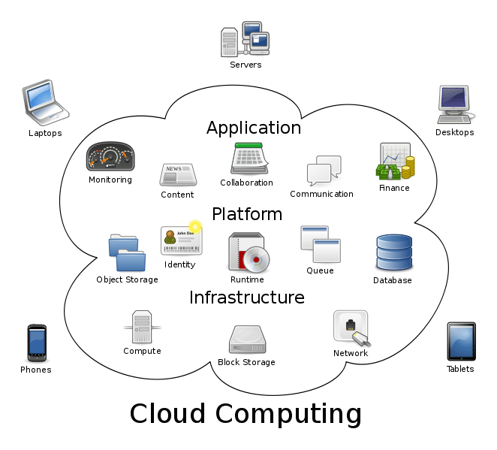
NCSC Cloud security guidance:
Data in transit protection
Asset protection and resilience
Separation between users
Governance framework
Operational security
Personnel security
Secure development
Supply chain security
Secure user management
Identity and authentication
External interface protection
Secure service administration
Audit information for users
Secure use of the service
Notes:
So far we have covered, the importance of cloud security, the role of the cloud security personnel, the types of attacks cloud is prone to, and why is cloud so easier to hack – what we will cover here very briefly are what to configure –
The cloud security guideance from the NSCS are These consideration points are : protecting your data in transit, assets, building resilience, separation of duties of your users, permissions each user would be given to the cloud, there is government framework, checks for operational security, supply chain security, secure user management and so forth. I’d recommend anyone embarking on a cloud security journey to read the NCSC guidelines on cloud security
Along side your cloud security assessment, there will also be a requirement to run a cloud security provider assessment – how do you that ?

Slide 18
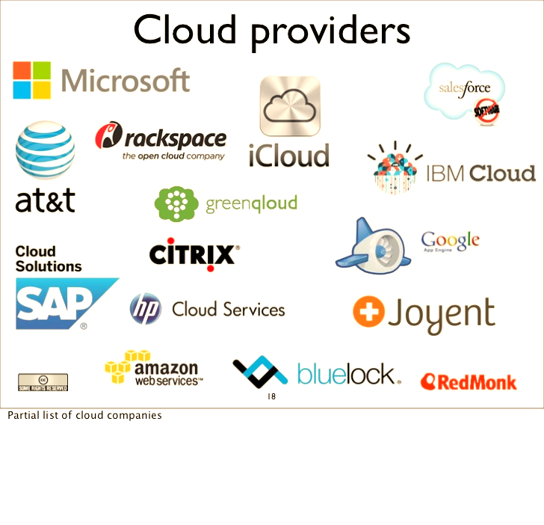
Cloud Service Provider assessment
Know your business requirements – availability, continuity are key
Understand Data flow, legal/regulatory implications of any data leak
Identify the risks the business is willing or unwilling to take
Verify the cloud service claims
Validate service supplier assurance claims
Identify additional risks/mitigations you can apply
Verify if acceptable risks are truly accepted by the business
Have regular service review with your cloud service provider
Notes:
To run a cloud security provider assessment : you have to
1 Know your business requirements: Understand your intended use of the cloud service. Consider issues such as availability and connectivity. Identify those risks which would be unacceptable to your organisation should they be realised, and those that would not.
2 Understand your information: Identify the information that will be processed, stored or transported by the cloud service. Understand the legal and regulatory implications. For example, if personal data is to be stored or processed, then the Data Protection Act should be considered.
3 Determine relevant security principles: You now know your business requirements, you’ve identified the risks you are/aren’t willing to take. And you have a clear picture of the information which will be exposed to the service. With this information you should be able to determine which of the Cloud Security Principles are most relevant to your planned use of the service.
4 Understand how the principles are implemented
Find out how the cloud service claims to implement the security principles you’ve identified as relevant. Different approaches will result in different risks for you to consider. Our detailed guide to implementing the cloud security principles will help you with this.
5 Understand the level of assurance offered - Can the service provider demonstrate that the principles you identified in step 3 have been implemented correctly?
Some suppliers offer little more than promises, others provide contracts, and some engage certified, independent assessors to validate their claims. The relative merits of these levels of assurance are explored in detail here.
6 Identify additional mitigations you can apply
Consider any additional measures your organisation (as a consumer of the cloud service) can apply to help reduce risk to your applications and information.
7 Consider residual risks
Having worked through the above steps, decide whether any remaining risks are acceptable.
8 Continue to monitor and manage the risks
Once in use, periodically review whether the service still meets your business and security needs.

Slide 19
How to secure data/assets in cloud
Visibility
Understanding flow of traffic
Control on who connects, and user/admin access
Enforcing policies points
Asset tagging, automatic enforcement of policies
Notes:
In the real world, as a security person how does it work ? There are sometimes, an acquisition or a new project being on boarded. There are some great minds at there doing a great job, whilst there are also lots of chaos out there. Sometimes as a security person, you are informed of this new project half-way before it goes live. Sometimes, you are brought in (good news) at the beginning of the project which is excellent, and you are fully involved as a security person – mostly enabling the security as opposed to disabling the company. And some other times, which is sadly a lot of the time, as a security person you are brought in to the project at a very late stage.
But at whichever point you are brought in – you have a job to deliver, and that is to secure the data, minimise business risks assosicated with data leakages/asset compromise. So,how do you go about achieving this.
You would need to first start with true visbility of all assets, you would need to understand the flow of traffic, who connects to where, where are the enforcement points – which polices are to be enforced, are the assets tagged, is there an automation for the enforcement of policies – and this is where dome9 as a tool comes into the picture to provide the visibility you require.

Slide 20
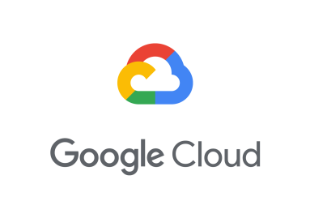
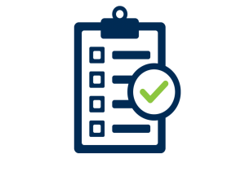

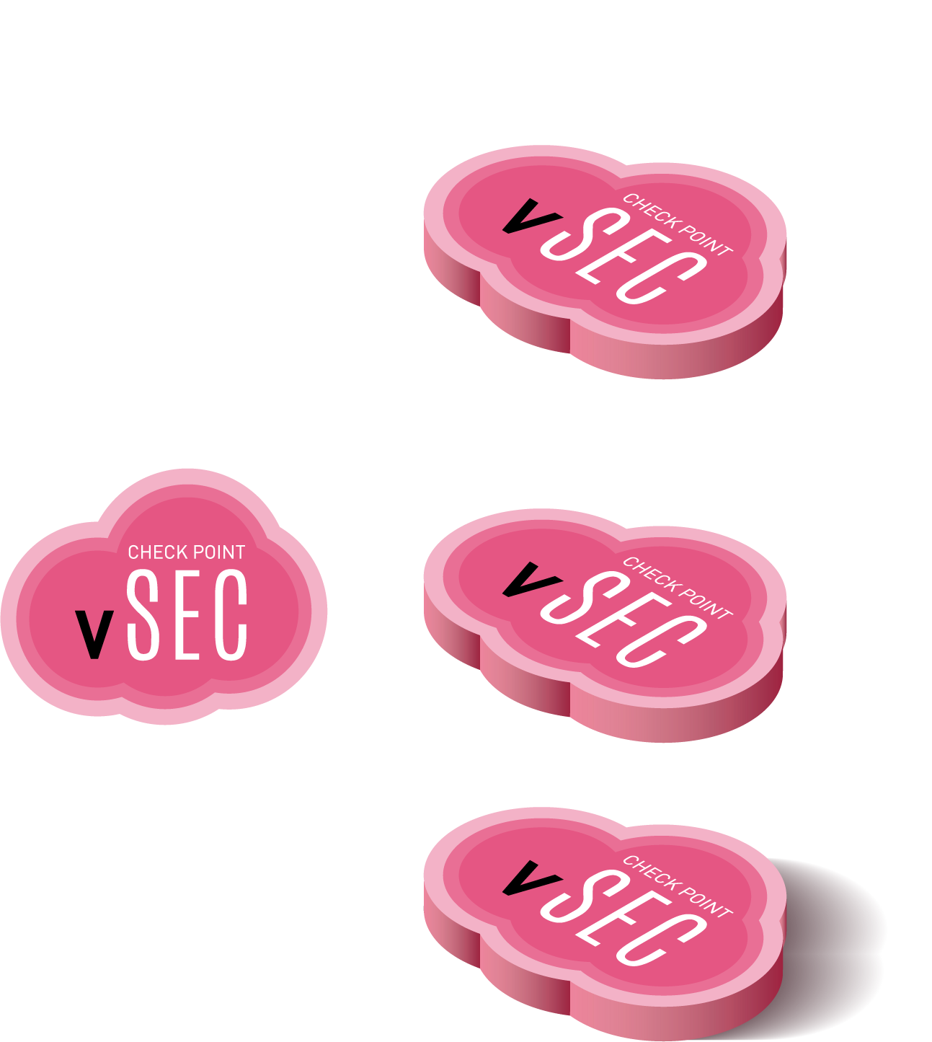
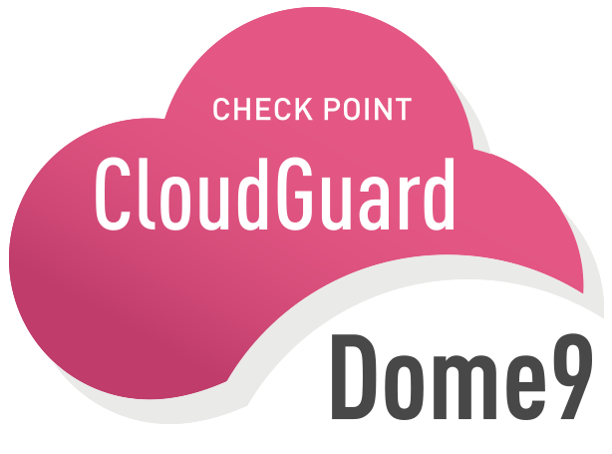




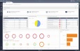
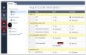
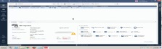
Continuous Compliance and Governance Single click Compliance assessment of your public cloud to evaluate security and compliance with best practices and industry standards (Such as HIPAA, PCI-DSS and more)
Automated remediation
Integration of Security and Compliance into CI/CD pipeline
Single pane of glass/control plane across the entire cloud footprint
Notes:
So why Dome9 -

Slide 21
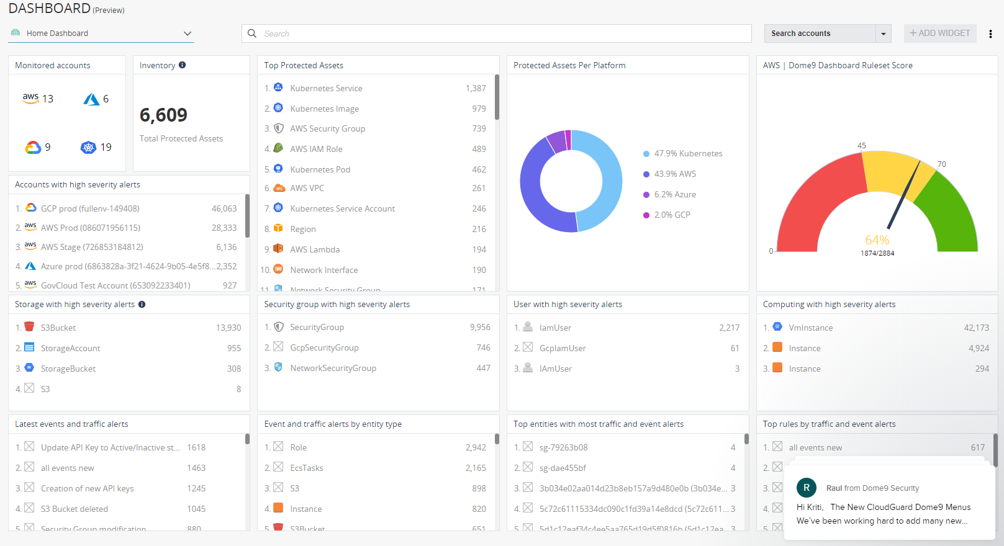
What is CloudGuard Dome9?
Notes:
Dome9 is a way to gain visibility, control of native security tools and compliance in public multi-cloud environments
Dome 9 minimizes the attack surface and protects against vulnerabilities, identifies theft and data loss
Dome 9 analyzes and visualizes the configuration and data flows in cloud accounts in a way that uncovers Security insights to the security administrator

Slide 22
Cloudguard Dome9
For the hands-on Check Point Dome9 Lab: Lab Guide https://shorturl.at/glpM3
To launch the lab as a user you may visit the lab registration page: https://bit.ly/2TFgaBt
For the activation code - please contact me/send me a message on Linkedin https://www.linkedin.com/in/kritim
Notes:
And use this activation code:
BCD9KMJUN20
Lab address:
https://drive.google.com/file/d/1NGpq4Bc1UyFuYxa6eocf7VaU7efLHOTG/view?usp=sharing

Slide 23

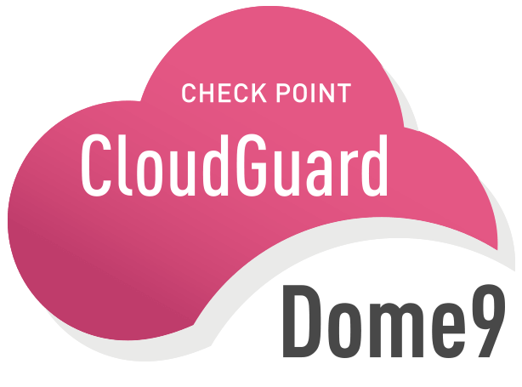
Thank You
https://uk.linkedin.com/in/kritim

Slide 24
What to secure in the cloud - assets / data / components / entities
Assets
Network security – security groups
Instances
Components / Entities
Identity access management
Notes:
To secure all these you want ot be able do the security in an automated fashion – why because multiple people can work in the cloud at the same time, multiple people are deploying different applications.updating / remember clioud is a dynamic environment, contimuously changing
Not just your front end applications developed by you, but also the back end – supply chain services, and the infrastructure. New integrations being discussed ever so often compared to traditional computing data centre.
When in the past, developpers would develop, stage, test then load into production – it would takes weeks if not months, years, now due to the how dynamic cloud computing is, the push into production timline has considerable reduced. In a highly dynamic environment, these could be weekly changes.

Slide 25




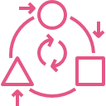
IAAS BUILDING BLOCKS
Centralized Management
Advanced Threat Prevention
Cloud Diversity
DevOps Ready
Adaptive and Automatic
Notes:
Centralized management to manage your public, private, hybrid and traditional data center. Consistent policy rules for all clouds!
We do prevention! – Best security Check Point can offer across clouds. N-S and E-W, this includes, AV, Anti-bot, Threat Extraction and Emulation, URL Filtering, Application Control
All Clouds – We support all major cloud platforms and the ecosystem is growing, latest to announce oracle cloud support
DevOps ready – We support full RESTful API and CLI access.
Adaptivness and automation – Support Auto-Provisioning via ready to use templates and APIs, Auto-Scaling security with PAYG licensing and thus, Auto-Protection with zero touch hassle. vSEC Adapts policy rules to application changes automatically.

Slide 26
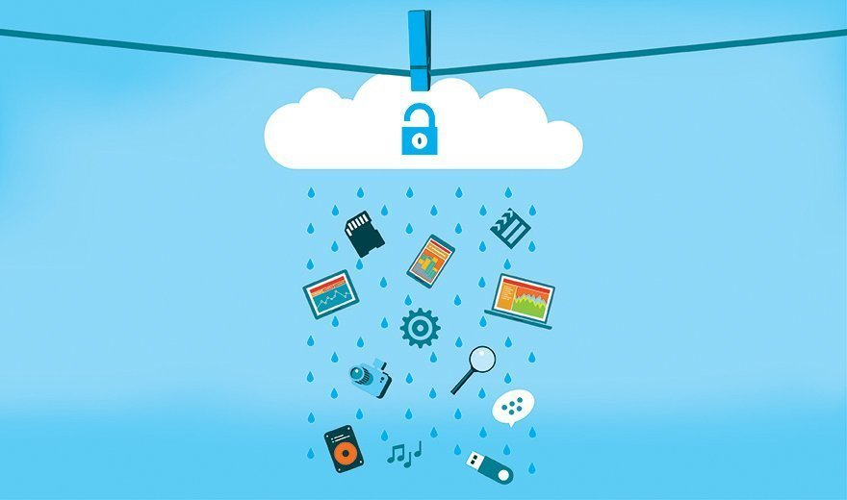
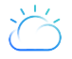

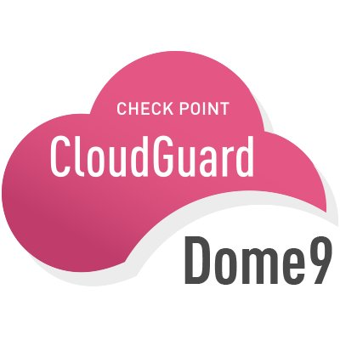


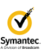
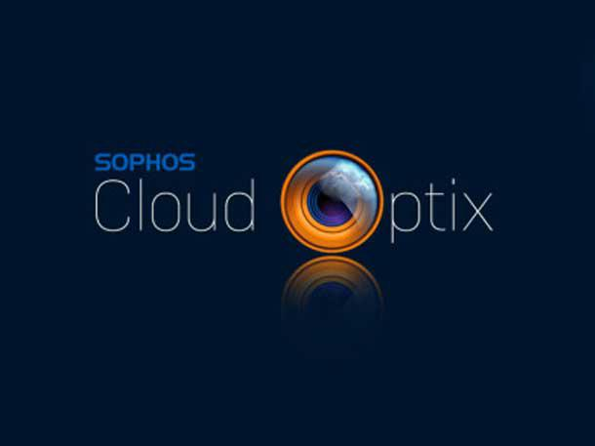
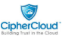


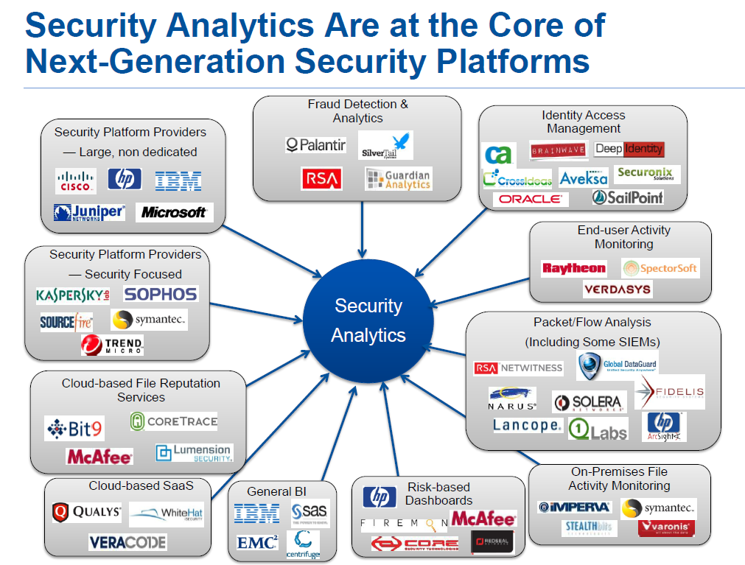
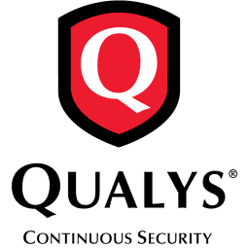


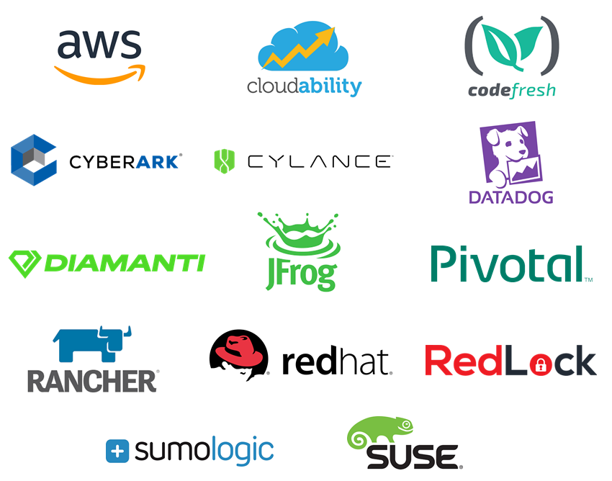
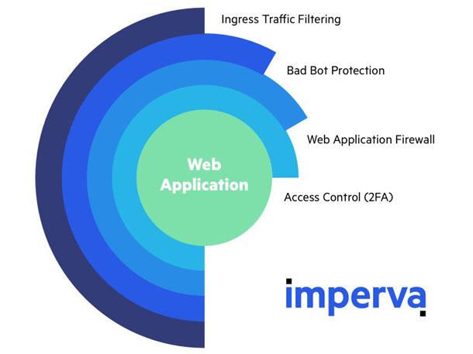

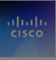
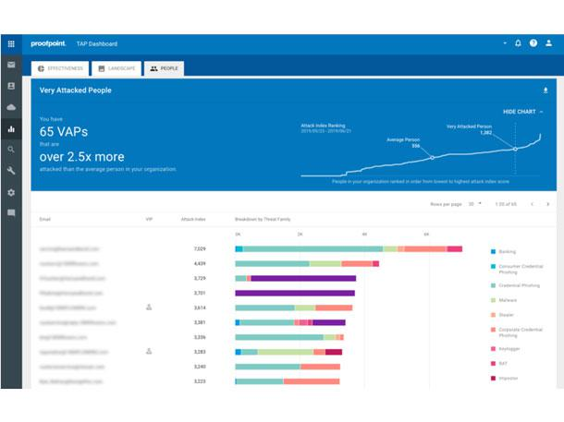
Cloud Security tooling

Slide 27
Are cloud services easier to hack ?
Accessibility to cloud platform
- Log from anywhere via web browser
- Multi user access
- lack of Identity Access Management
- Root account credentials access
Misconfiguration
Unencrypted storage / DBs
Visibility – Lack of Asset management
Insecure interfaces and APIs
Security compliance

